Slide 1

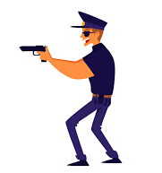
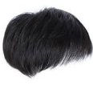
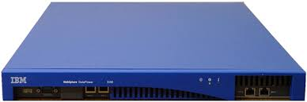
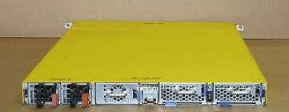
FBI
President
Barack
Obama
IBM
Daimler AG
Saint Anselm: WWI
WWII
San Quinton
Prision
Governor
Gavin Newsom
Former
Vice President
Federal(US) Republic
Germany

Slide 2

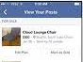
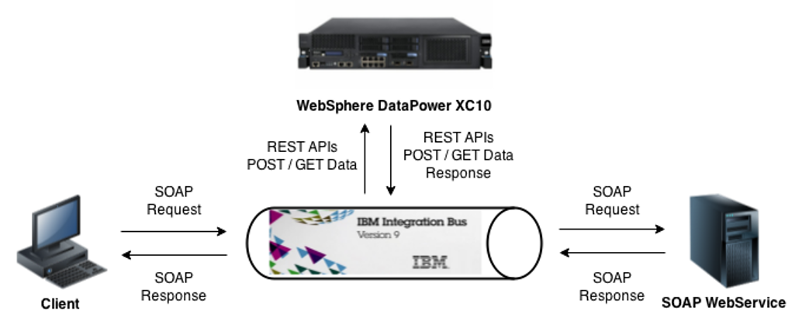
FBI
Black
President
Barack
Obama
Soap(xml)
Soap(xml)toHTML
)
Langley: manthew:15, Content Item
Sugerhill
Gorh(micha, Andrew; short text)
Phil(kim)
Black
Governor
Gavin Newsom
Black
Former
Vice President
Federal(US) Republic
Germany
)
)

Slide 3
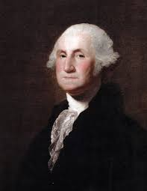
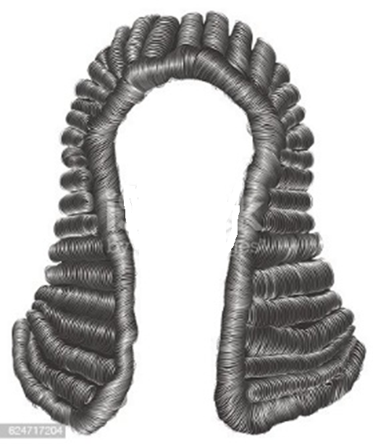
FBI

Slide 4
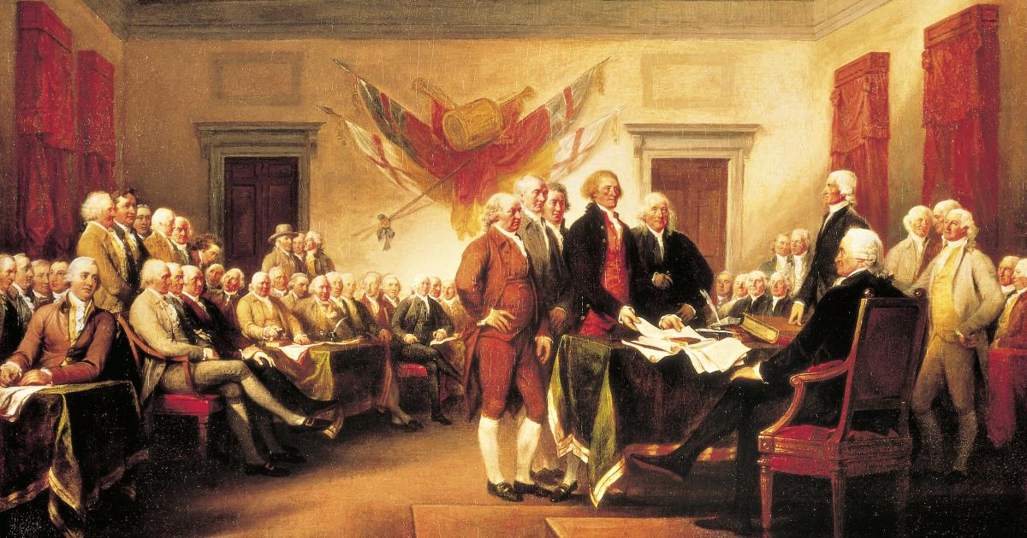
FBI

Slide 5


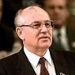

FBI
President Barack Obama
Marin County
Germany
Select * from nonPoliceTRX AND nonPoliceBpmViolations
WHERE
nonPoliceBpmViolations.CODE
in (WWI AND WWII, PHIL, IRAQ)
Ibm.damiler.ghocheo(dr/j,hahn)
The person with PHYSICS

Slide 6
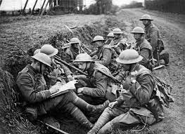
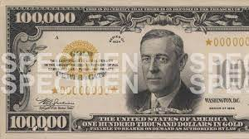


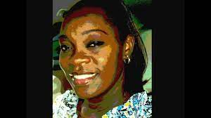
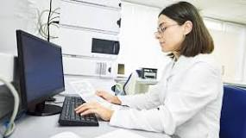
FBI
ATOMICCLOCK
(Quartz Circle)
Bert, al
Mazx-plan sap
Hahn; sap
Ibm.damiler.ghocheo(dr/j,hahn)
The person with PHYSICS
On April 1, 1972, five former IBM employees Dietmar Hopp, Hasso Plattner, Claus Wellenreuther, Klaus Tschira, and HansWerner Hector started the company
LUX(Walldorf, Germany, Kreis Kraichtal; County King Kraichtal
SPECIMEN
https://www.sap.com/industries/defense-security.html
SPECIMEN
Gary: SAP
SPECIMEN

Slide 7

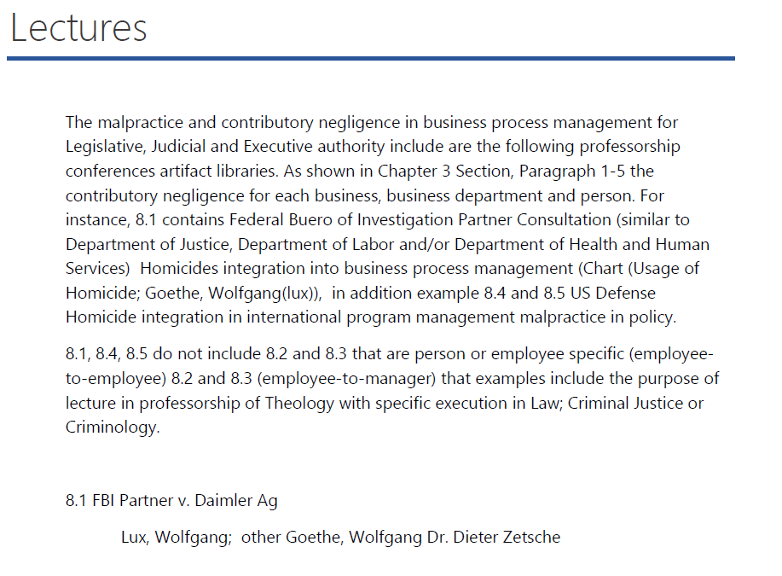
FBI
WAR
(kriegstrasse)
KING
(bismarkstrasse)
TERRORISM
nonPoliceRadio

Slide 8
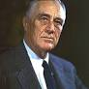



FBI
WAR
(kriegstrasse)
KING
(bismarkstrasse)
TERRORISM
nonPoliceRadio
Former
Vice President
Federal(US) Republic
Germany
Fidelities, Karlsruhe
Swr3 2001 WAR HEIDELBERG (peter and paul,mika)
Swr4 2016 US BASE FRANKFURT(RHEIN-MAIN)
Swr3 2010 KING kitchen Wieland,thomas
ATOMICLOCK
FBI
RELIGIOS CRIME
Fidelities, Karlsruhe
Anachy School, Univeirty
Dr. Roos; Mathematics IV
Gary: ibm.damiler.visa.appe.BLACK
ibm.dmiler.visa.telsa.RED
mark travis BLACK - Anacyr POLCIE STATION FOSTER CITY
nonPoiceRTA(ripplelabs;paymetns)
[x] no
0.1 phil( mccarhty).nonPolcieRTA(BLACK/RED)
Anachy School, Univeirty
FBI.CHILD PORNOGRAPHY VICTUMS ASSISTANCE(CPVA)

Slide 9
FBI
WAR
(kriegstrasse)
KING
(bismarkstrasse)
TERRORISM
nonPoliceRadio

Slide 10
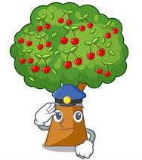

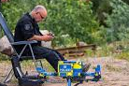

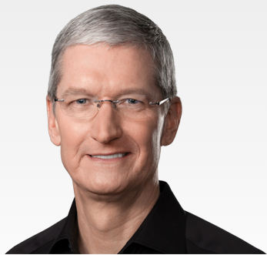
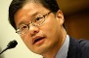
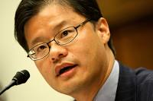
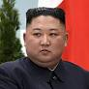
FBI
WAR
(kriegstrasse)
KING
(bismarkstrasse)
TERRORISM
FBI.CHILD PORNOGRAPHY VICTUMS ASSISTANCE(CPVA)
FBI: HOMCIDE( Arien Johs, Boden)
?
Black
Soap(xml)toHTML
Niko Johs
Axel Johs
?
41.Walking at lake
In Baby Boys
ASSHOLE
Cutting open
ASSHOLE with
Gittel Axel Rasors
My sweater
Gerlach, Kim

Slide 11
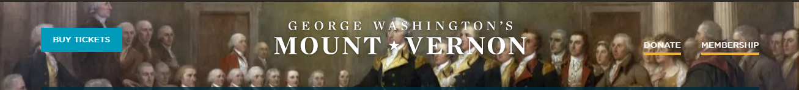
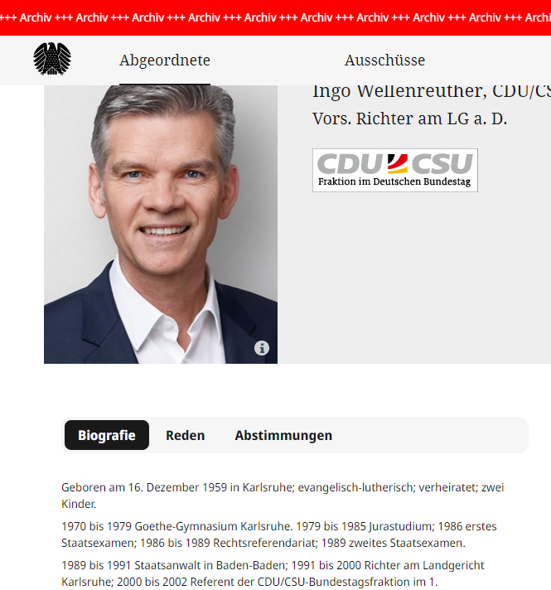
FBI
G.Freemasonry; Gerard Larios(G) Backup Sabry Tozin
WAR
(kriegstrasse)
KING
(bismarkstrasse)
TERRORISM
FBI.CHILD PORNOGRAPHY VICTUMS ASSISTANCE(CPVA)
FBI: HOMCIDE( Arien Johs, Boden)
HOMCIDE:LUX
Wolfgang, Lux
Wolfgan, Goethe
ONE WORD
Is that the correct word for Damierl Ag? Dr. Deiter Zeteche?
Shoud I change the word?
Pankakes, San Anslemo
Governance, Visa David Worth
ONE WORD

Slide 12
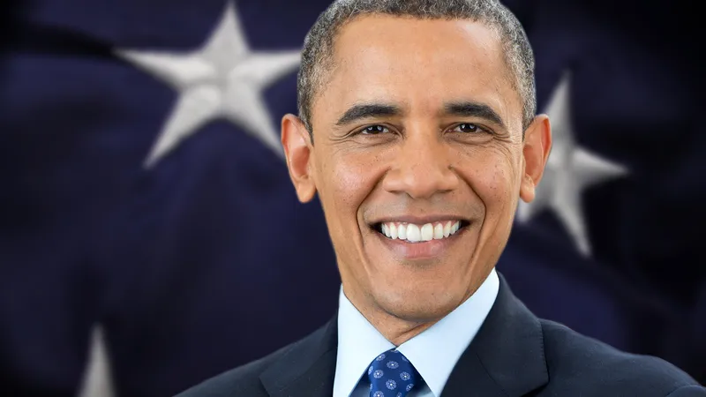
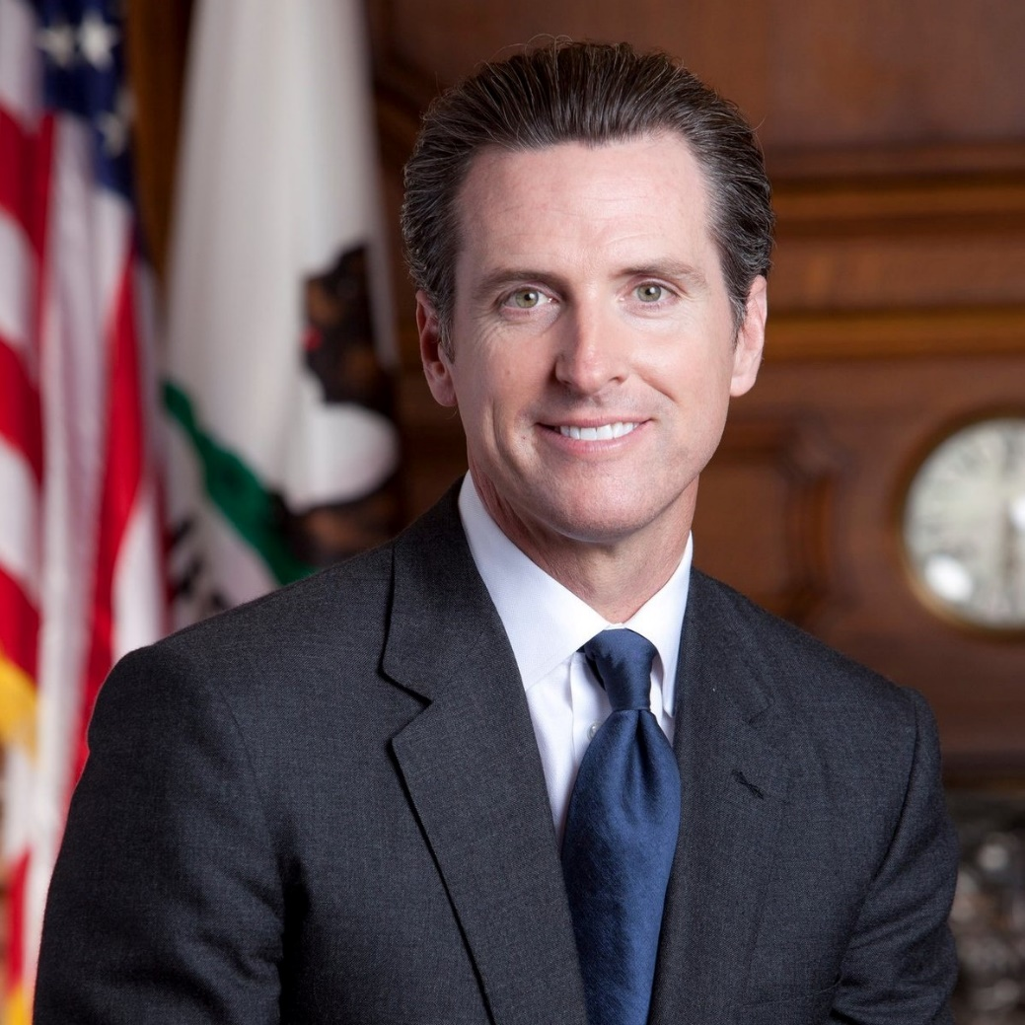
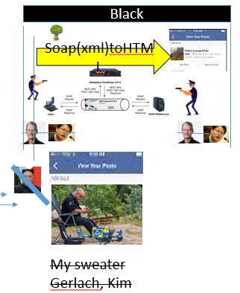

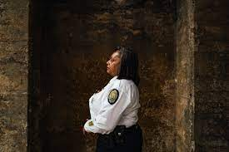
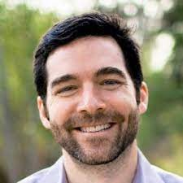
FBI
WAR
(kriegstrasse)
KING
(bismarkstrasse)
TERRORISM
Nick Adami Paytouch
Found this
Brad, Hamition Visa Cyberour Authrize.net
Pit

Slide 13
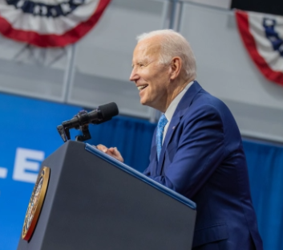

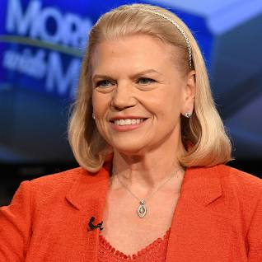
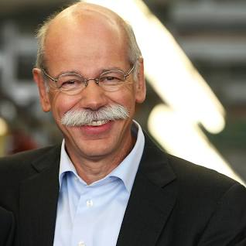
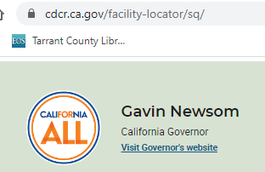
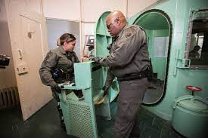
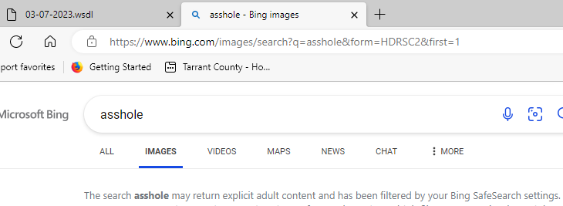
FBI
TERRORISM
former
next
former
next
Was former
former

Slide 14
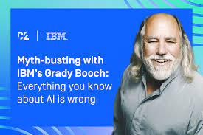
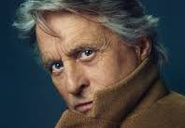
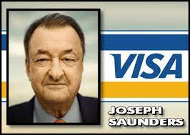
FBI
LUX(elko, cum lets go, viloa lux)
TERRORISM
int32
I found this

Slide 15
FBI
TERRORISM
int64
LUX(wolfgang)
=
Vggg(ss)
Jossphe saunder 63
Vigini rometi 65
Ingo 64
Dr. Deiter Zecheio 0
or

Slide 16

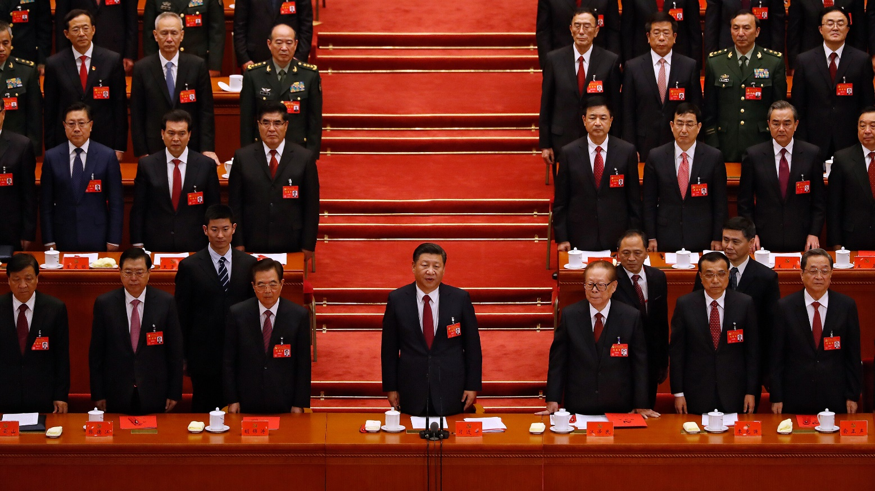
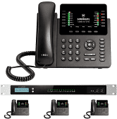
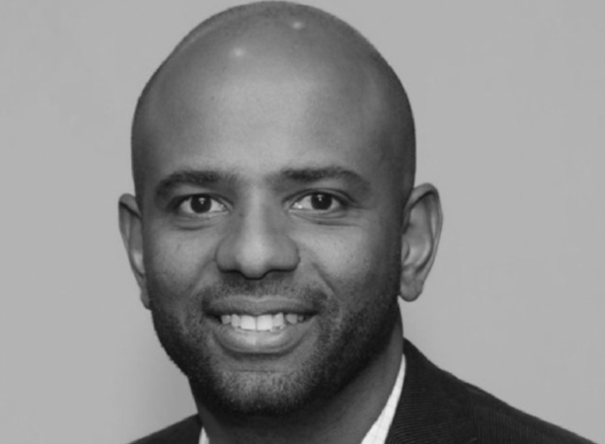
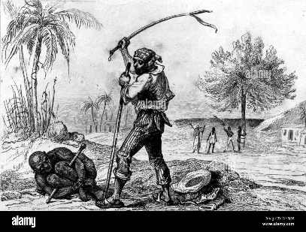
FBI
TERRORISM
https://www.cupertino.org/our-city/departments/public-safety-programs/sheriff-s-office/neighborhood-watch legtion cutperion polcie

Slide 17
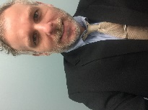

FBI
TERRORISM
41 Jordone Saundras Cousin

Slide 18

FBI
TERRORISM

Slide 19
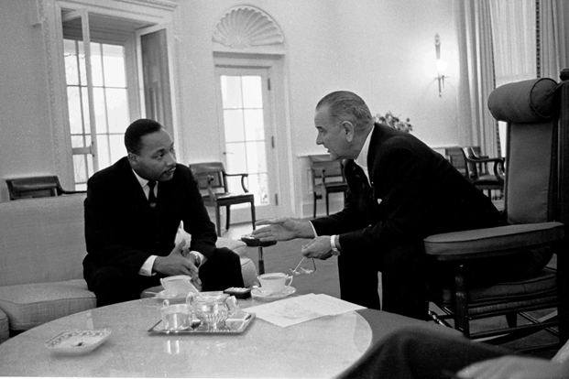
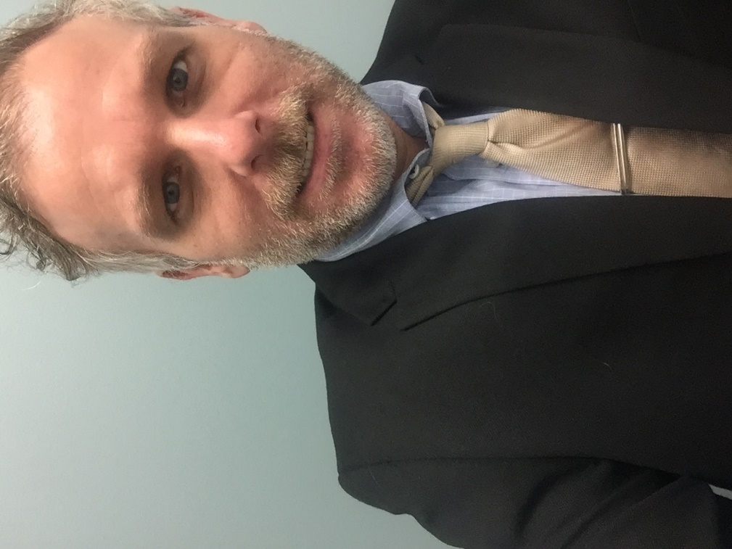
FBI
TERRORISM

Slide 20
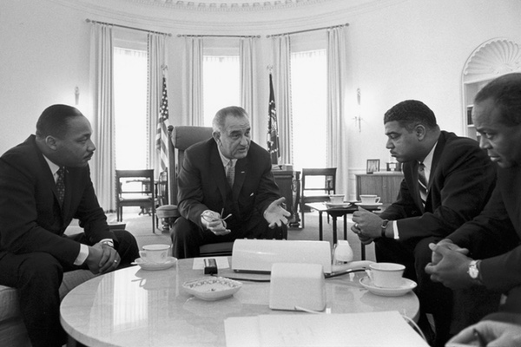
FBI
TERRORISM

Slide 21
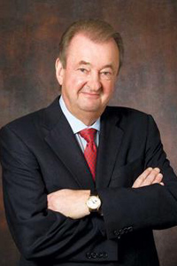
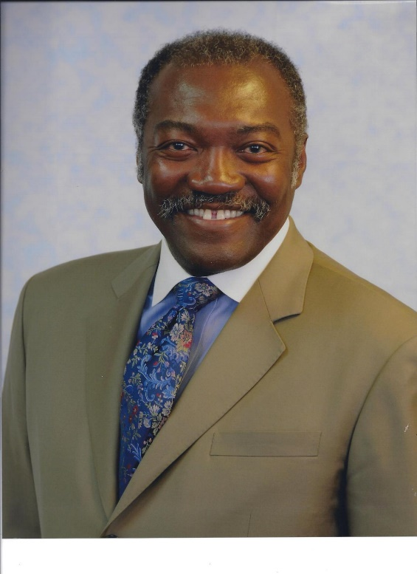
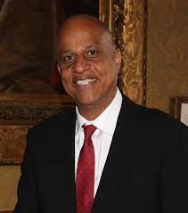
FBI
TERRORISM
Chair
Accenteru
PayByTouch
Micheal King
Accenture
PayByTouch
Sabry Tozin Accenture
PayByTouch

Slide 22
FBI
TERRORISM
Chair
Accenteru
PayByTouch
I Will Touch Your Daughers
Vagaina
--Eula,
Were do I sign?
Donminqu IS-A-BELL
[x] no
Paul- 1M

Slide 23


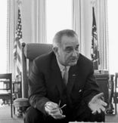






FBI
TERRORISM
2007/8
=
Micheal King
Accenture
PayByTouch
2015
=
Wiener / mussshi =

Slide 24
FBI
TERRORISM
Jordon

Slide 25

FBI
TERRORISM
Jordon

Slide 26

FBI
TERRORISM

Slide 27







FBI
TERRORISM
Mr. Rogers
Son of John(MINSSOATA)
[x] no
Adam and LUX
allegations of domestic violence
and a serious cocaine habit.
string of arrests and
restraining orders
in Minnesota

Slide 28





FBI
TERRORISM
Hollow Wood, Larry
Accenture PayByTouch
HOLLYWOOD
LARRY

Slide 29

FBI
January 2012
TERRORISM
January 2012
…

Slide 30
FBI
TERRORISM
January 2012
Journal of Experimental Botany, Vol. 50, No. 334, pp.
565–571, May 1999
Effect of modified carbon allocation on turgor, osmolality, sugar and potassium content, and membrane potential in the epidermis of transgenic potato (Solanum tuberosum L.) plants
January 2012
Journal of Experimental Botany, Vol. 50, No. 334, pp.
565–571, May 1999
The effects of modification in sugar concentrations on example, potassium or chloride, contribute both to the turgor pressure and membrane potential in epidermal generation of membrane polarity via their Nernst poten- leaf cells of transgenic potato (Solanum tuberosum cv. tial and to the production of turgor. To elucidate the Desire´ e) plants were studied. Measurements of turgor

Slide 31





FBI
TERRORISM
CVPA
HOMICIDE
LISA ROTH
January 2012
Journal of Experimental Botany, Vol. 50, No. 334, pp.
565–571, May 1999
We want to ensure optimum use of our website
Nernst poten- leaf cells of transgenic potato (Solanum
tuberosum cv. tial and to the production of turgor.
To elucidate the Desire´ e) plants were studied. Measurements
of turgor
Effect of modified carbon allocation on turgor, osmolality,
January 2012
Journal of Experimental Botany, Vol. 50, No. 334, pp.
565–571, May 1999
L.) plants
The effects of modification in sugar concentrations on example, potassium or chloride, contribute both to the turgor pressure and membrane potential in epidermal generation of membrane polarity via their
Kit, 71-0017

Slide 32

FBI
TERRORISM
CVPA
HOMICIDE
January 2012
Journal of Experimental Botany, Vol. 50, No. 334, pp.
565–571, May 1999
We want to ensure optimum use of our website
Nernst poten- leaf cells of transgenic potato (Solanum
tuberosum cv. tial and to the production of turgor.
To elucidate the Desire´ e) plants were studied. Measurements
of turgor
Effect of modified carbon allocation on turgor, osmolality,
January 2012
Journal of Experimental Botany, Vol. 50, No. 334, pp.
565–571, May 1999
L.) plants
The effects of modification in sugar concentrations on example, potassium or chloride, contribute both to the turgor pressure and membrane potential in epidermal generation of membrane polarity via their

Slide 33

FBI
TERRORISM
CVPA
HOMICIDE

Slide 34
FBI
TERRORISM
CVPA
HOMICIDE
FIRST STREET

Slide 35

FBI
TERRORISM
CVPA
HOMICIDE
FIRST STREET

Slide 36

FBI
TERRORISM
CVPA
HOMICIDE
FIRST STREET
VIRGINIA SWORN
VOLUME 1

Slide 37

FBI
TERRORISM
CVPA
HOMICIDE
FIRST STREET
VIRGINIA SWORN
VOLUME 1

Slide 38

FBI
TERRORISM
CVPA
HOMICIDE
FIRST STREET
VIRGINIA SWORN
VOLUME 1
“25

Slide 39
FBI
TERRORISM
CVPA
HOMICIDE
FIRST STREET
VIRGINIA SWORN
VOLUME 1
“25

Slide 40
FBI
TERRORISM
CVPA
HOMICIDE
FIRST STREET
VIRGINIA SWORN
VOLUME 1

Slide 41

FBI
TERRORISM
CVPA
HOMICIDE
FIRST STREET
VIRGINIA SWORN
VOLUME 1
“60

Slide 42
FBI
TERRORISM
CVPA
HOMICIDE
FIRST STREET
VIRGINIA SWORN
VOLUME 1
“128

Slide 43
FBI
TERRORISM
CVPA
HOMICIDE
FIRST STREET
“130 MINUTES

Slide 44



FBI
TERRORISM
CVPA
HOMICIDE
FIRST STREET
“60
“128
“128

Slide 45



FBI
TERRORISM
CVPA
HOMICIDE
FIRST STREET
“60
“128
“128

Slide 46
FBI
TERRORISM
CVPA
HOMICIDE
ATOMCLOCK
8-QBIT
CHILD PORNOGRAPHY
VICTUMS ASSITANCE(CVPA)

Slide 47





FBI
TERRORISM
CVPA
HOMICIDE
ATOMCLOCK
8-QBYTE
CHILD PORNOGRAPHY
VICTUMS ASSITANCE(CVPA)
8-BIT
1
0
0
1
0
1
1
0
Larry Page
Larry Wall, Perl

Slide 48

FBI
TERRORISM
CVPA
HOMICIDE
ATOMCLOCK
8-QBIT
CHILD PORNOGRAPHY
VICTUMS ASSITANCE(CVPA)

Slide 49


FBI
8-QBYTE
TERRORISM
Jordon

Slide 50


FBI
CHILD PORNOGRAPHY VICTUMS ASSITANCE(CVPA)
TERRORISM
f({x0,x1,x2,...})→0 or 1 , where xn is 0 or 1
nonPoliceQByte nonPoliceVagina = {0,0}
nonPoliceVagina = {1,1}
Deutsch(nonPoliceVagina)
Deutsch-Josch(nonPoliceVagina)
Hot Qbyte Vagaina
https://quantum-computing.ibm.com/lab/files/qiskit-textbook/content/ch-algorithms/deutsch-jozsa.ipynb

Slide 51
FBI
CHILD PORNOGRAPHY VICTUMS ASSITANCE(CVPA)
TERRORISM

Slide 52



FBI
CHILD PORNOGRAPHY VICTUMS ASSITANCE(CVPA)
TERRORISM

Slide 53

FBI
CHILD PORNOGRAPHY VICTUMS ASSITANCE(CVPA)
TERRORISM

Slide 54
FBI
CHILD PORNOGRAPHY VICTUMS ASSITANCE(CVPA)
TERRORISM

Slide 55

FBI
CHILD PORNOGRAPHY VICTUMS ASSITANCE(CVPA)
TERRORISM
IS-A-BELL
FRANCE MILITARY
BARACKS
BADEN-BADEN
Bernou and Wife
Foster Mark
Google Bam Bullet
O
O
H’sandra

Slide 56
FBI
CHILD PORNOGRAPHY VICTUMS ASSITANCE(CVPA)
TERRORISM

Slide 57

FBI
TERRORISM
POLICE

Slide 58

FBI
TERRORISM
IT IS 10:10

Slide 59


FBI
POLICE
TERRORISM

Slide 60
FBI
TERRORISM
IBM
DAIMLER
VISA
APPLE
$10.10
$10.10
$10.10
$10.10

Slide 61
FBI
POLICE
TERRORISM

Slide 62

FBI
POLICE
For Children
TERRORISM

Slide 63

FBI
POLICE
For Children
TERRORISM

Slide 64

FBI
POLICE
For Children
TERRORISM
nonPoliceQByte nonPoliceVagina = {0,0

Slide 65
FBI
POLICE
TERRORISM

Slide 66
FBI
TERRORISM
Scrooge
Richie Rich
Sylvestor
Minni
$0.10
$0.10
$0.10
$0.10

Slide 67
FBI
POLICE
TERRORISM

Slide 68
FBI
POLICE
For Children
TERRORISM
nonPoliceQByte nonPoliceVagina = {0,0

Slide 69
FBI
POLICE
For Children
TERRORISM

Slide 70
FBI
WAR
(kriegstrasse)
KING
(bismarkstrasse)
TERRORISM
nonPoliceRadio

